Slide 1
Canopy
‘Your journalling ecosystem.’
Temiya, Abdul, Joanne, Ram, Ateola

Slide 2
Problem and Pain Points
Approx. 30% of apprentices (sample 1000) felt they weren’t educated or supported by their universities or employers for logging OTJ hours and completing weekly journal entries.

Slide 3
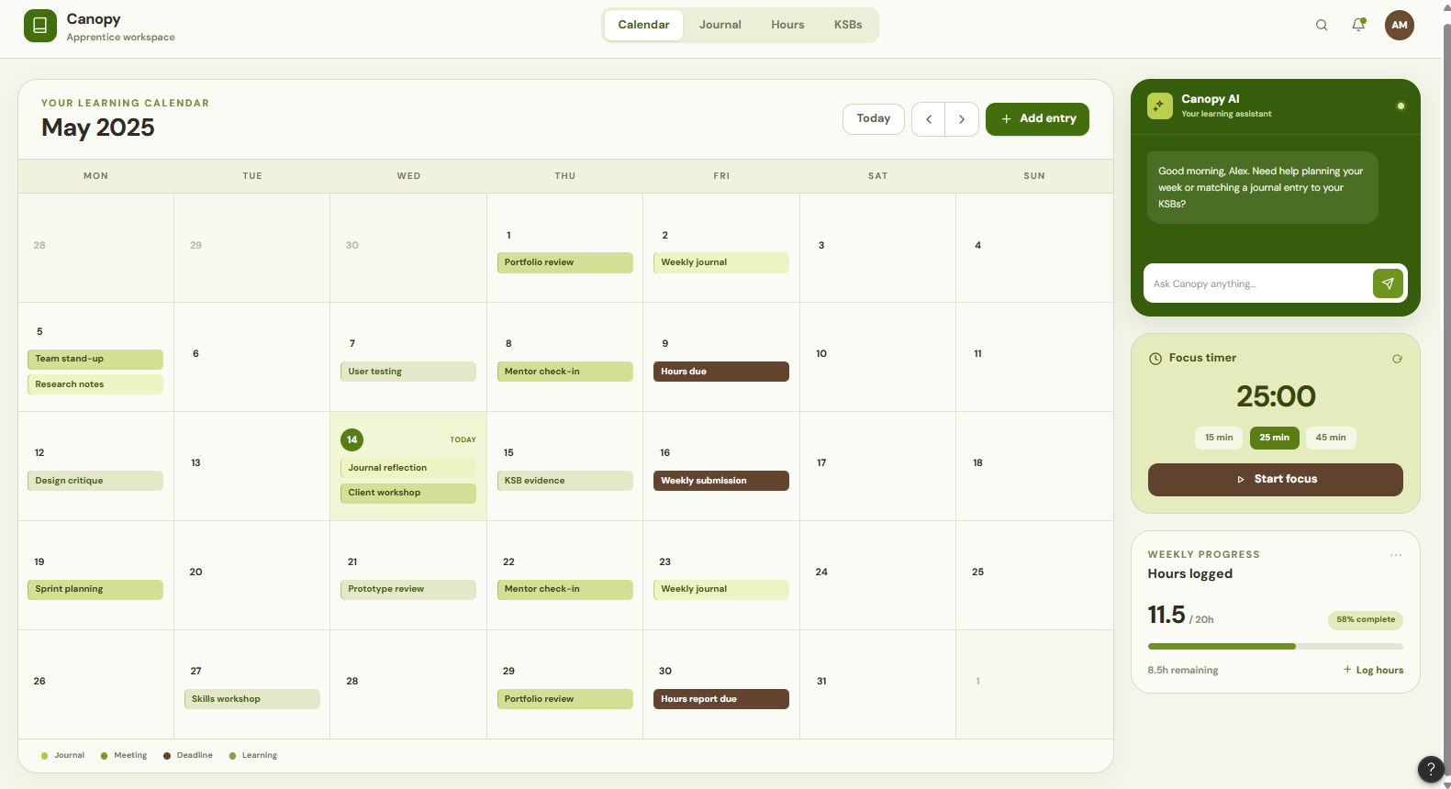
Solution
A centralised directory for events, summaries and meetings
Your university, work and apprenticeship combined into one space!
Concept UI design plan shown below
Calendar view helps visualise the chosen month’s events, assignment deadlines and any important meetings coming up

Slide 4
Technical Capabilities

Slide 5
Demo >_<

Slide 6
Future Scalability
Mass solving
Uni collaborations

